Slide 1
Movie Recommendation System: NLP-Based Recommender System
Submitted by:
22JK1A0543 KAITEPALLI NAGARAJU
22JK1A0527 BATTULA VISHNU
22JK1A0528 BIKKI VISHNU VARDHAN
22JK1A0529 RAHUL SAI BOJJANKULA
Under the Guidance of
K SRINIVAS REDDY
ASST. PROFESSOR
Department of Computer Science & Engineering
KITS AKSHAR INSTITUTE OF TECHNOLOGY
Affiliated to JNTU Kakinada
2025-26

Slide 2
CONTENTS
• Abstract
• Literature Survey
• Existed System
• Proposed System
• Design Analysis
• Architecture
• Working
• Technologies Used
• Output Screens

Slide 3
Abstract
Movie recommendation systems are essential in helping users discover relevant content from large movie collections. This project focuses on an NLP-based Movie Recommendation System that analyzes movie descriptions and related textual metadata to recommend similar movies. By understanding the context and meaning of text, the system provides content-based recommendations that go beyond basic genre matching, improving personalization and relevance. The core technologies used in this project revolve around Natural Language Processing and machine learning techniques. The system is implemented using Python, with NLP libraries such as NLTK or spaCy for text preprocessing. TF-IDF is used to convert movie descriptions into numerical feature vectors, and cosine similarity is applied to measure the closeness between movies. These techniques form the foundation of the recommendation logic and enable effective comparison of textual content.The project flow begins with collecting and preparing a dataset containing movie titles, genres, and descriptions. Text preprocessing is performed to clean and normalize the data, including tokenization, stop-word removal, and lemmatization. The processed text is then transformed using TF-IDF, and similarity scores are calculated between movies. Based on a selected movie, the system identifies and recommends the most similar movies using NLP-based similarity measures.
In conclusion, the project demonstrates how NLP techniques can be effectively applied to build a content-based movie recommendation system. By focusing on textual understanding, the system delivers accurate and meaningful recommendations without relying on user ratings. This approach highlights the importance of NLP in modern recommender systems and provides a strong foundation for future enhancements such as hybrid models or deep learning-based recommendations.

Slide 4
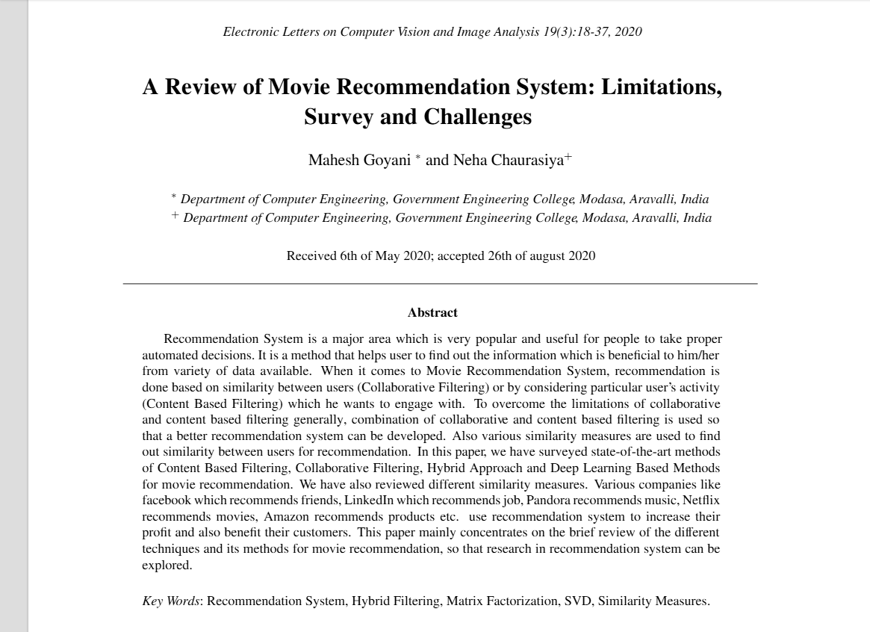
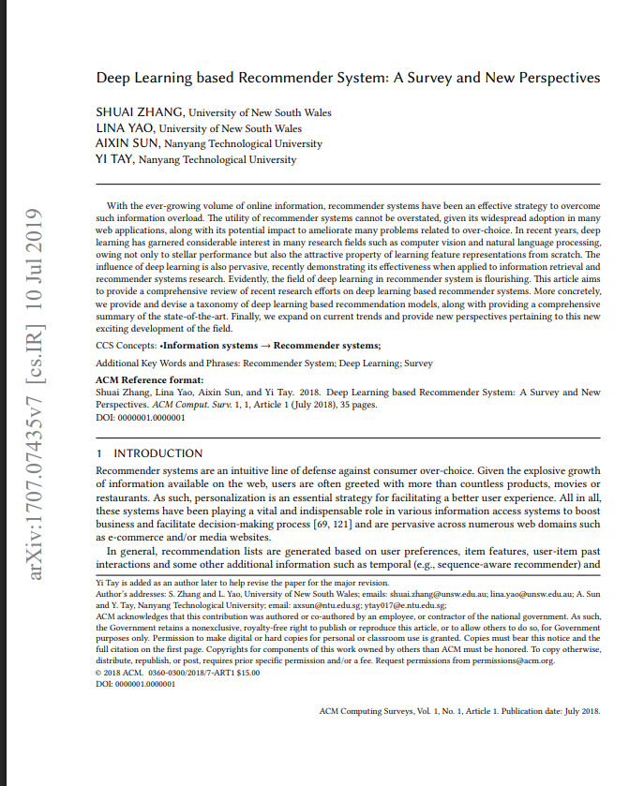
Literature Survey:
Cold-start problem
Sparse rating data
Scalability issues
Weak semantic understanding
Over-specialization

Slide 5
Existed System:
Text Preprocessing
Tokenization, stop-word removal, stemming, and lemmatization are applied to plot summaries, movie overviews, or reviews.
Feature Extraction (NLP-Based)
Movie text is converted into numerical form using models such as:
TF-IDF (Term Frequency–Inverse Document Frequency)
Bag-of-Words (BoW)
Word2Vec / GloVe embeddings
Doc2Vec
BERT / Transformer embeddings (in modern systems)
Similarity Calculation
Movies are compared using similarity measures such as:
Cosine Similarity
Euclidean Distance
Dot Product
The system finds movies whose text descriptions are most similar to the input movie.
Recommendation Generation
Based on textual similarity, the system retrieves and displays the top-N similar movies to the user.

Slide 6
Proposed System:
The purpose of the proposed system is to create a movie recommendation framework that understands what a movie is truly about—its storyline, themes, emotions, and overall context—by processing its textual description. Using semantic embeddings and similarity techniques, the system finds the most logically and contextually related movies to the one selected by the user. This enables users to discover movies aligned with their narrative preferences, even without providing explicit ratings or watch history.

Slide 7
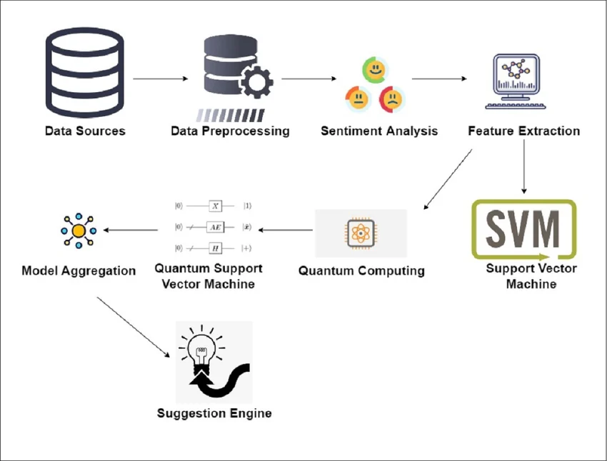
Design Analysis
User Inputs Movie Title
Backend Receives Input via API
Movie Title is Matched in Dataset
NLP Module Converts Movie Overviews to TF-IDF Vectors
Similarity Engine Computes Cosine Similarity
Top N Similar Movies Identified
Results Returned to Frontend
Frontend Displays Recommended Movies

Slide 8



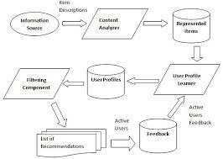
Architecture

Slide 9
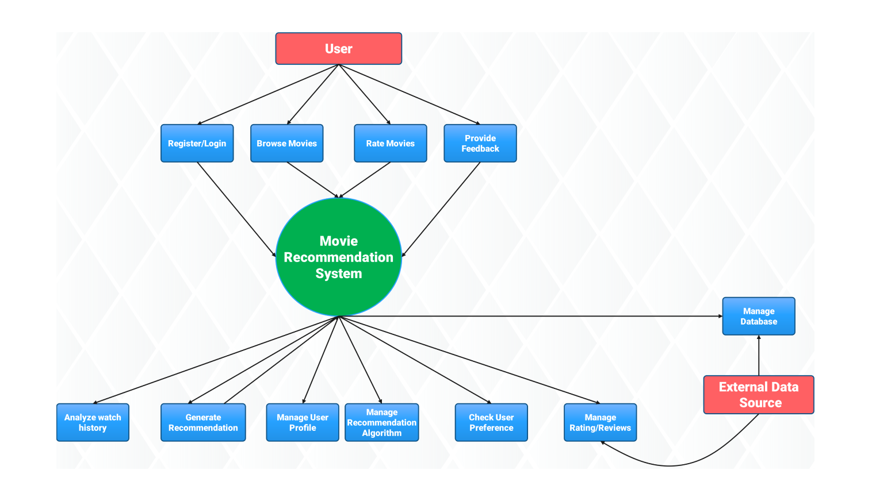
Working:
User enters a movie title
Frontend sends request to Flask backend
Backend searches for the movie in dataset
NLP processing using TF-IDF
Cosine similarity computed with all movies
Top similar movies selected
Backend returns recommendations as JSON
Frontend displays final recommended movies

Slide 10
Technologies Used:
Python – Core programming language for implementing the recommendation system.
Pandas & NumPy – Used for data preprocessing and efficient data handling.
NLTK / spaCy – Applied for Natural Language Processing tasks.
Scikit-learn – Used for TF-IDF vectorization and cosine similarity.
Jupyter Notebook – Used for development, testing, and visualization.

Slide 11
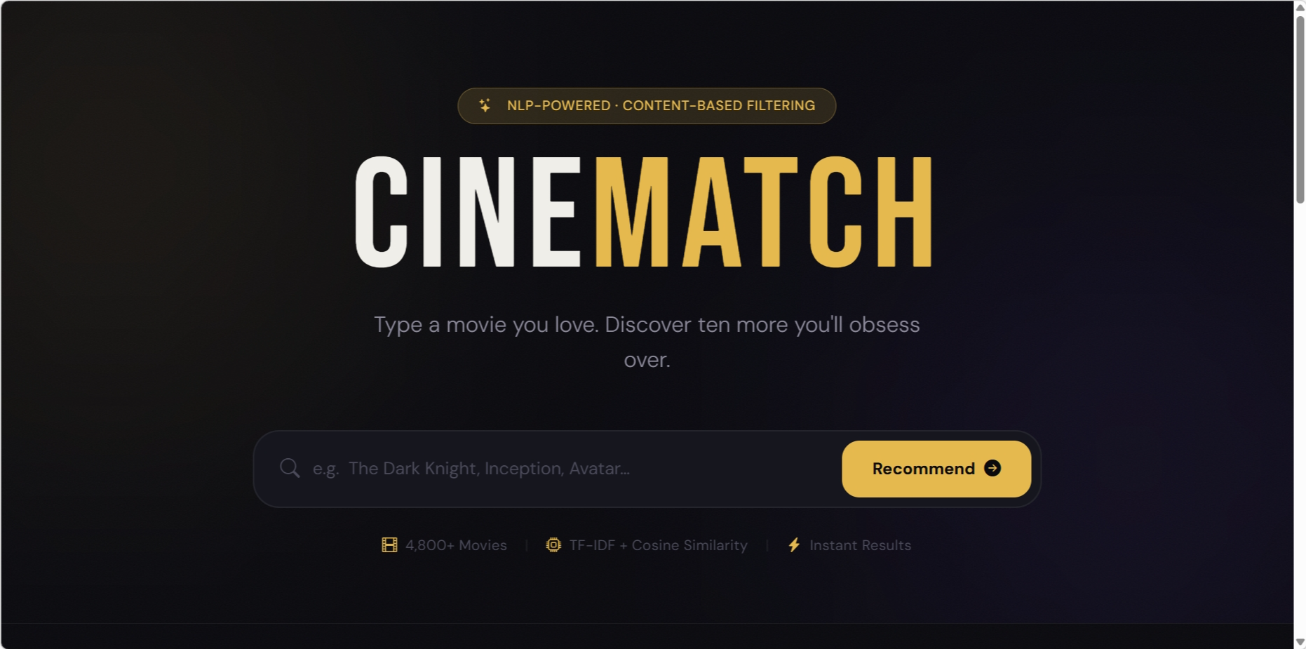
Output Screens

Slide 12


